Slide 1

CVS Retail Store
Anish Reddy Yennam, Chuandong Liu, Daniel Gregory Schall, Mateen Gebrael Rasoli, Maxwell Nathaniel Oglesby

Slide 2

Background
CVS = “Consumer Value Stores”
First CVS store was founded in 1963 and sold health and beauty products in Massachusetts
Founded by brothers Stanley and Sidney Goldstein & partner Ralph Hoagland
Designed a database to manage their online & in-person sales to satisfy customer requirements
Keep track of storage/stock of products
Keep track of in-person/online customers with the CVS card
Keep track of damages, theft, etc. regarding products
Created a table on special offers & discounts.

Slide 3
E-R Diagram

Slide 4
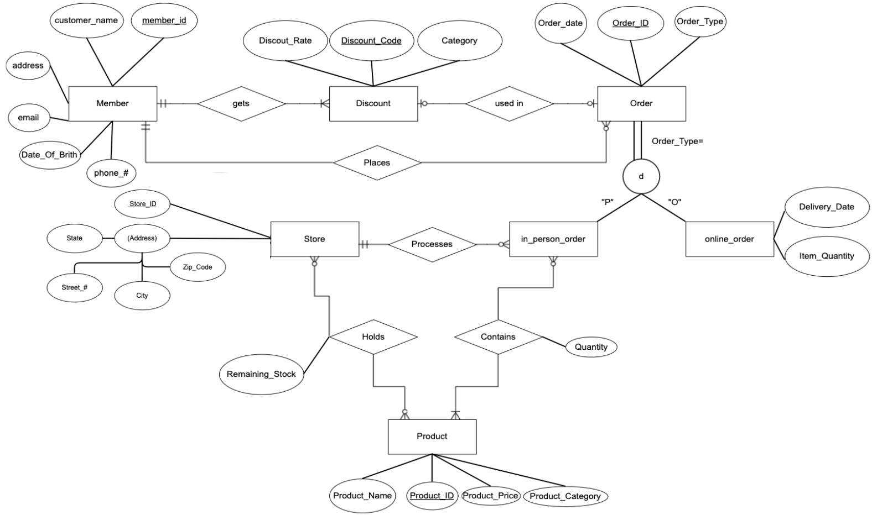
7 Strong Entities
No Weak Entities
1 Supertype - Subtype relationship
1 one to one relationship
3 one to many relationship
2 many to many relationship

Slide 5
Normalized Table
Member(Member_ID, Customer_Name, Address, Email, Phone_#, Date_Of_Birth)
Discount(Discount_Code, Discount_Rate, Category, Member_ID)
Orders(Order_ID, Order_Date, Order_Type, Member_ID, Discount_Code)
Online_Order(O_Order_ID, Delivery_Date, Item_Quantity)
In_Person_Order(P_Order_ID, Store_ID)
Product(Product_ID, Product_Name, Product_Price, Product_Category)
Store(Store_ID, Street_Address, City, State, Zip_Code)
Store_Holds_Product(Store_ID, Product_ID, Remaining_Stock)
In_Person_Order_Contains_Product(P_Order_ID, Product_ID, Quantity)

Slide 6
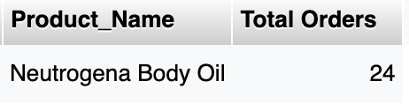
Query 1
SELECT Product.Product_Name, SUM(In_Person_Order_Contains_Product.Quantity) AS 'Total Orders'
FROM Product, In_Person_Order_Contains_Product
WHERE Product.Product_ID = In_Person_Order_Contains_Product.Product_ID
GROUP BY Product.Product_Name
ORDER BY SUM(In_Person_Order_Contains_Product.Quantity) DESC
LIMIT 1;
Business Problem:
Which product has the most sales?
Notes:
SELECT product_1.Product_Name, SUM(in_person_order_contains_product.Quantity)
FROM product_1, in_person_order_contains_product
WHERE in_person_order_contains_product.Product_ID = product_1.Product_ID
ORDER BY SUM(in_person_order_contains_product.Quantity) DESC LIMIT 1;

Slide 7
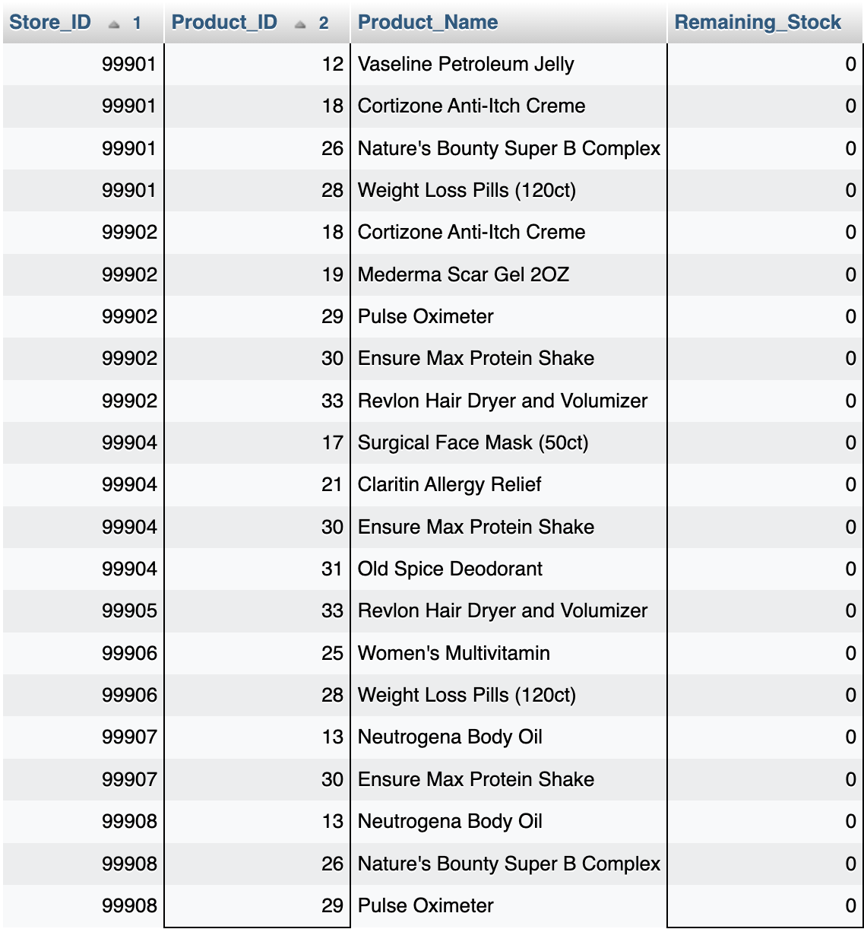
Query 2
SELECT Store_Holds_Product.Store_ID ,Store_Holds_Product.Product_ID, Product.Product_Name, Store_Holds_Product.Remaining_Stock FROM Store_Holds_Product, Product
WHERE Remaining_Stock = 0
AND Product.Product_ID = Store_Holds_Product.Product_ID
GROUP BY Store_ID, Product_ID;
Business Problem:
Which products require more inventory?

Slide 8
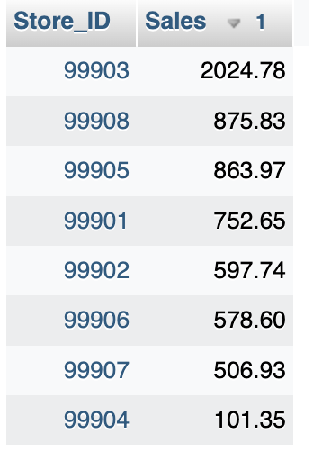
Query 3
SELECT Store_ID, SUM(In_Person_Order_Contains_Product.Quantity * Product.Product_Price) AS 'Sales'
FROM In_Person_Order LEFT JOIN In_Person_Order_Contains_Product
on In_Person_Order.P_Order_ID = In_Person_Order_Contains_Product.P_Order_ID
LEFT JOIN Product on In_Person_Order_Contains_Product.Product_ID = Product.Product_ID
GROUP BY Store_ID
ORDER BY Sales DESC;
Business Problem:
Which store has the most sales?

Slide 9
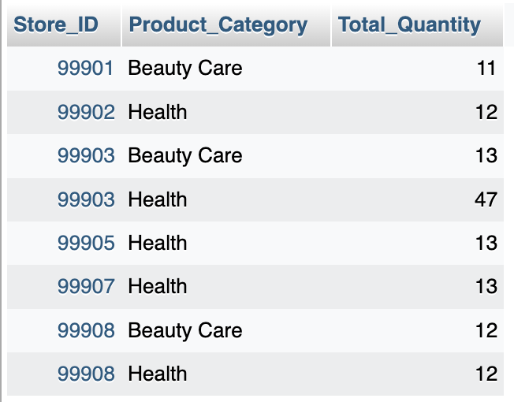
Query 4
SELECT Store_ID, Product_Category, SUM(In_Person_Order_Contains_Product.Quantity) AS Total_Quantity
FROM In_Person_Order LEFT JOIN In_Person_Order_Contains_Product
on In_Person_Order.P_Order_ID = In_Person_Order_Contains_Product.P_Order_ID
LEFT JOIN Product on In_Person_Order_Contains_Product.Product_ID = Product.Product_ID
GROUP BY Store_ID, Product_Category
HAVING Total_Quantity > 10;
Business Problem:
Which Product Categories have more than 10 items sold for all of the stores?
Notes:
What is the best selling Product Category for each of the stores?

Slide 10
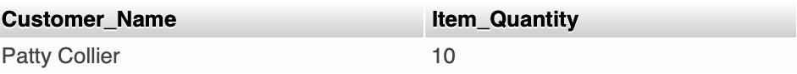
Query 5
SELECT Member.Customer_Name, Online_Order.Item_Quantity FROM Online_Order LEFT JOIN Orders ON Online_Order.O_Order_ID = Orders.Order_ID LEFT JOIN Member ON Member.Member_ID =Orders.Member_ID ORDER BY (item_quantity * 1) DESC LIMIT 1;
Business Problem:
Which customer made the largest online purchase?

Slide 11
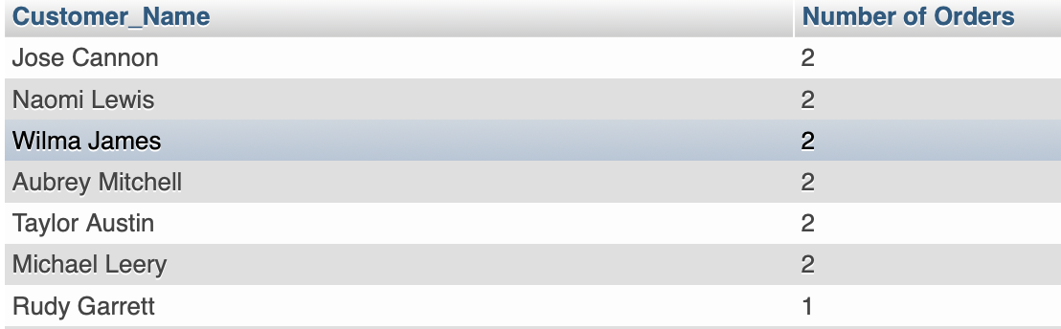
Query 6
SELECT Member.Customer_Name, COUNT(Member.Customer_Name) AS "Number of Orders" FROM In_Person_Order LEFT JOIN Orders ON In_Person_Order.P_Order_ID = Orders.Order_ID LEFT JOIN Member ON Member.Member_ID = Orders.Member_ID GROUP BY Member.Customer_Name ORDER BY COUNT(Member.Customer_Name) DESC;
Business Problem:
Who is CVS’s most recurring customer from In-Person orders?

Slide 12
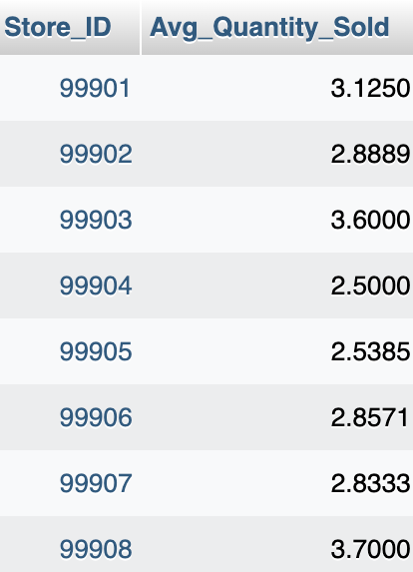
Query 7
SELECT In_Person_Order.Store_ID, (SUM(In_Person_Order_Contains_Product.Quantity)/ COUNT(In_Person_Order_Contains_Product.P_Order_ID)) AS 'Avg_Quantity_Sold'
FROM In_Person_Order_Contains_Product, In_Person_Order
WHERE In_Person_Order.P_Order_ID=In_Person_Order_Contains_Product.P_Order_ID
GROUP BY Store_ID;
Business Problem:
What is the average items purchased from each of CVS’s stores?
Notes:
SELECT avg(-----) FROM -----

Slide 13
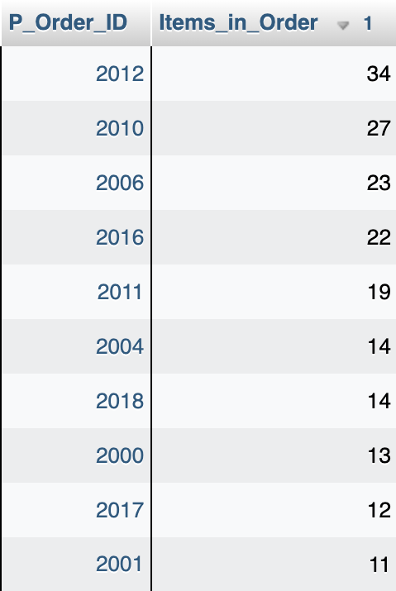
Query 8
SELECT In_Person_Order_Contains_Product.P_Order_ID, SUM(In_Person_Order_Contains_Product.Quantity) AS 'Items_in_Order'
FROM In_Person_Order_Contains_Product, In_Person_Order
WHERE In_Person_Order.P_Order_ID=In_Person_Order_Contains_Product.P_Order_ID
GROUP BY P_Order_ID
ORDER BY Items_in_Order DESC
LIMIT 10;
Business Problem:
What are the 10 largest orders based on the quantity of items sold?
Notes:
SELECt MAX(-----) FROM ------

Slide 14
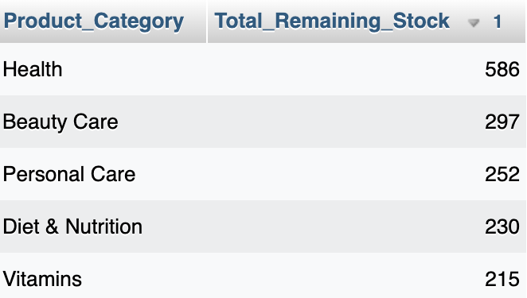
Query 9
SELECT Product.Product_Category, SUM(Store_Holds_Product.Remaining_Stock) AS 'Total_Remaining_Stock'
FROM Product, Store_Holds_Product
WHERE Store_Holds_Product.Product_ID=Product.Product_ID
GROUP BY Product_Category
ORDER BY Total_Remaining_Stock DESC;
Business Problem:
How much inventory does each Product Category have left in stock?
Notes:
SELECT MIN(-----) FROM ------

Slide 15
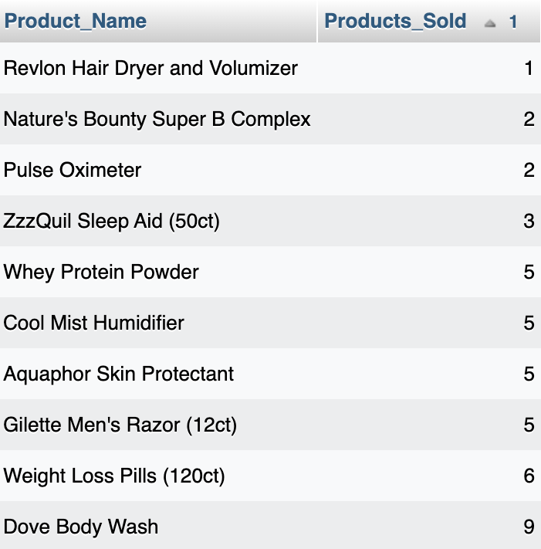
Query 10
SELECT Product.Product_Name, SUM(In_Person_Order_Contains_Product.Quantity) AS 'Products_Sold'
FROM In_Person_Order_Contains_Product, Product
WHERE In_Person_Order_Contains_Product.Product_ID = Product.Product_ID
GROUP BY Product_Name
ORDER BY Products_Sold
LIMIT 10;
Business Problem:
What are the Top 10 lowest selling products based on recent In-Person sales?

Slide 16
Thank You

Slide 17
Questions？

